Slide 1
4. Playing technique
Training
Audio
576 * 4 samples (strike, buzz, flam, drag)
Get Activation: PFNMF
Around maximum
150ms front, 200ms back
Select Activation Segment
Crest
Centroid
Flatness
IOI mean & std
Nearby peaks to main peak distance & amplitude ratio
Extract Activation
Features
Train SVM
SVM model

Slide 2
4. Playing technique
Testing
Audio
28 annotated tracks
Get Activation: PFNMF
Now using the ground truth
Select Activation Segment
Onset Detection
Extract Activation
Features
SVM predict
Classification result

Slide 3
Evaluation process
Entire track
Time
Annotated region
……..
Annotated onsets
1: TP
OTHERS: FP
Right class: TP
OTHERS: FN????

Slide 4
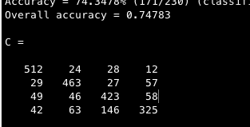
Test 1
Simple 10-fold cross validation on the training data
Strike, Buzz, Flam, Drag
Strike, Buzz, Flam, Drag

Slide 5
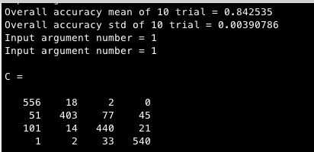
Test 2
Simple 10-fold cross validation on the training data
Center adjustment
Windowing
Strike, Buzz, Flam, Drag
Strike, Buzz, Flam, Drag

Slide 6
Audio
Training
Testing
Extract NMF Activations
Select Activation Segment
Drum Transcription
Feature
Extraction
Classification
Training
Classification Testing
Results

Slide 7
Δt
Δt1
Δt2
α
α
t
t

